Slide 1
Summary Report for BFX–UA300
Quality Issue on May-2022 Product.
Prepared by: Rachel Ruan
Reviewed by: Toney Tu
Approved by: CB Lin
Date: 2022-Aug-25

Slide 2
Issue Description
30-June-2022, ALT customer complain [BFX-UA300] 2022.May Mass production issue.
Overall inspection result => Fail ( Waived, due to product launch schedule )
Defect Total:
•Critical
Status LED not work * 1 pcs/200
Ethernet unstable * 1 pcs/200
No sound output * 1 pcs/200
•Major
No screen after booting animation. * 1 pcs/200
Cosmetic damage * 1 pcs/200
•Minor
Screw assembly * 1 pcs/200
Tact feeling is not good * 1 pcs/200

Slide 3
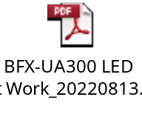
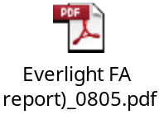
1. LED not work
Issue Description | FA | Root cause | Actions | Status
Symptom: Led not work Type: Critical Defect unit Q’ty : 1/200pcs Defect rate : 0.5% SKB SN: 2149695001202201006480 | 1. Fail symptom: As ALT feedback that they found out 1pcs LED is not working 2. Check FATP data → product pass normally →On FATP : LED function tested at FT1 station (With factory software) and RC1 station ( With customer software) This issue can cover on FATP 3. FA - Take X-ray and VI D22 location → Normal. - Measure impedance of D22 location → Normal. - Measure voltage of D22 location → Have abnormality on pin 1,2,3. - Swap verification between D22 NG sample and D22 OK sample. (This issue follow D22 ( P/N: 123.00701.005 ) | Root cause Occurrence : 1. May cause from vendor LED incoming material ( Auto test and tapping station ). 2. And may cause Fii On line process from SMT to FATP can make D22 crack/ brocken. Root cause Escape: 1. That time ( 12-Apr ), production line did not check LED by the auto testing program. 2. OP check LED by visual inspection at FT1 station may be he did not check carefully and passed to next test station. | Action from LED vendor: Request Everlight vendor provide corrective action for 2 risk station : Auto EL test and Tapping . Due date: 2022/08/29 Action from Fii production line: Apply auto check LED at FT1 station for test all LED light function . Done: 2022/04/23 | On Going

Slide 4
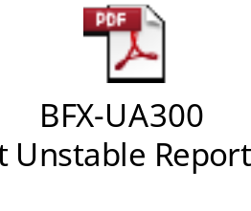
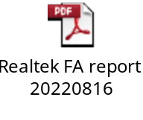
3. Ethernet unstable
Issue Description | Root cause | Actions | Status
Symptom: Ethernet unstable Type: Critical Defect unit Q’ty : 1/200pcs Defect rate : 0.5% SKB SN: 2149695001202201006508 | Root Cause for Occur: After SWAP verified, the defect (CRC NG) follow Ethernet PHY IC U801. (P/N: 002.02152.005, Vender: Realtek, D/C: DL50) Realtek tested the function of the IC, it showed NTF. Fii RD re-confirmed the IC defect with CRC NG. Realtek suspected this Ethernet PHY IC (U801) has compatibility issue SoC IC (U1). Fii SW RD adjust the SoC side Ethernet RX delay, it can improve the CRC issue. ➔The compatibility issue between SoC IC (U1) and Ethernet PHY IC U801. Root Cause for Escape: PT station CRC test item can cover this issue, but the test program of PT station bypass CRC. | Action for Occur: Fii SW RD try the Ethernet RX delay parameter to find the best solution. It need more data to study the parameter, suggest to collect the data during the production. Action for Escape: PT station implemented the CRC test. (Done) | Ongoing

Slide 5
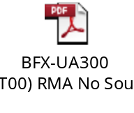
3. No sound output
Issue Description | FA | Root cause | Actions | Status
Symptom: No sound output Type: Critical Defect unit Q’ty : 1 / 200pcs Defect rate : 0.5% SKB SN: 2149695001202201006507 | 1. Fail symptom: As ALT feedback that they found out 1pcs No sound output 2. Check FATP data → pass normally →On FATP : Sound function tested at FT2 station (With factory software) and RC1 station ( With customer software) This issue can cover on FATP 3. FA - Visual Top & Bot side of NG sample → Repaired at 5R67,5R68, R108 locations and solder more jump at 2con1 location - Take X-ray U1, RAM, Flash → Normal. - Measure the impedance at the position of the resistors next to J813 → Found out abnormal. - Retest FT2 & OBA station → Pass 5/5 times - Power on and play music by external internet within 3 hours ➔ Normal - Power on/off ( on 3minutes, off 30s) to check sound output ➔ Normal. | ➔ This is NTF issue | ➔ Fii will keep monitor this issue. | Monitor

Slide 6
4. No screen after booting animation
Issue Description | FA | Root cause | Actions | Status
Symptom: No screen after booting animation Type: Major Defect unit Q’ty : 1/200pcs Defect rate : 0.5% SKB SN: 2149695001202201007918 | 1. Fail symptom: As ALT feedback that they found out 1pcs No screen after booting animation 2. Check FATP data → pass normally →At RC1, RC2 station : test program will check QR code and display remote capture when product finish booting as the picture bellowing: → This issue can cover at RC1, RC2 station | → This issue has happened before and Customer FW: 19.532.16 has bug. → Confirmed with RD and customer this issue and they still not provide method to fix it. | Short term: - Factory will re- download customer FW 19.532.16 to solve this case. Long term: - Continue to work with RD to find a method to fix this issue | Monitor

Slide 7
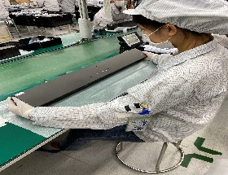
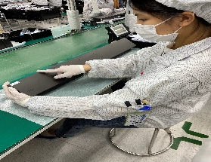
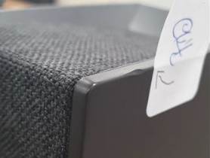
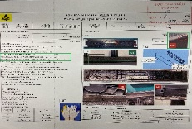
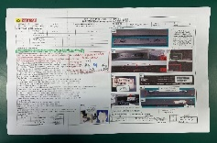
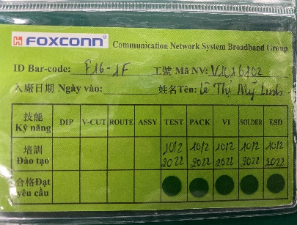
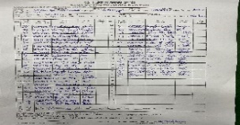
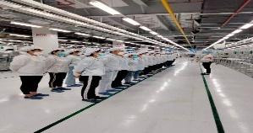
5. Cosmetic damage
Issue Description | Root Cause | Actions | Status
Symptom : Dented on the side of the top case Type: Major Defect unit Q’ty : 1/200 pcs Defect rate : 0.5% | The May-2022, online had defect Top housing had damage when OP open housing carton check visual before assembly. We had inform to Inkel vendor notice this issue and request Inkel sorting before ship to Fii. On production line, OP no check careful housing TOP case had damage. 3. Visual Inspection station: OP - V1001210 Nguyen Thi Hong -Line 9. | 1. Re-training OP check housing incoming and assembly , VI . Status : Done 2. Update NG picture to SOP and Hang quality arlam on this station for OP notice it. Status : Done 3. Before run line , line leader training OP, notice quality online issue, IPQC defect issue, OBA issue, read SOP and quality alarm. Status : Done | Monitor

Slide 8
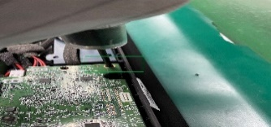
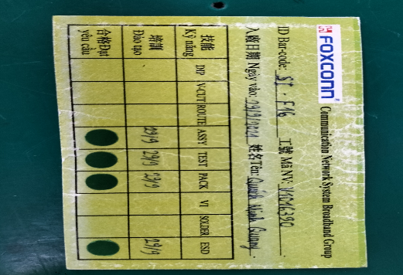
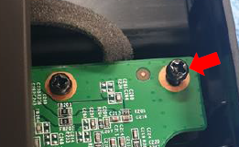
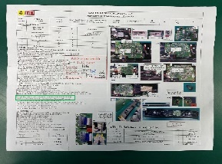
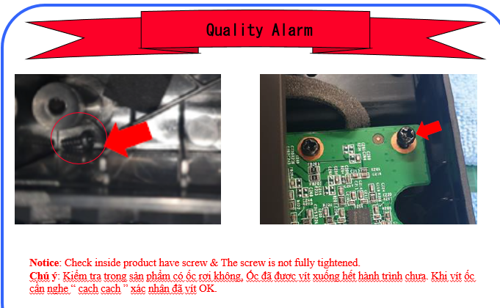
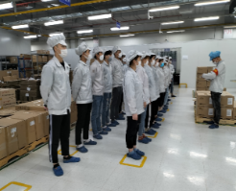
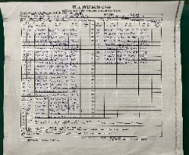
6. Screw assembly
Issue Description | Root Cause | Actions | Status
Symptom : The screw is not fully tightened Type: Minor Defect unit Q’ty : 1/200 pcs Defect rate : 0.5% | 1. OP assembly AMP main doing no follow SOP, Screw need confirm by 2 “cach cach”. 2. OP no re-check by himself before transfer to next station. 3. OP doing this station : V1016390 Quach Minh Quang. | 1. Re-training OP doing follow SOP. Status : Done 2. Update NG picture to SOP. Quality alarm hang online for OP notice it. Status : Done 3. Before run line , line leader training OP, notice quality online issue, IPQC defect issue, OBA issue, read SOP and quality alarm. Status : Done | Monitor

Slide 9
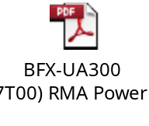
7. Tact feeling is not good
Issue Description | FA | Root cause | Actions | Status
Symptom : Power button tact feeling is NG Type: Minor PCBA check : one tact switch feels NG in PCBA level. | 1. Fail symptom: As ALT feedback that they found out 1pcs tact feeling is not good 2. Check FATP data SN ➔ Pass normally. 3. Check Visual inspection and X-Ray all is normal. 4. Check by Mustimeter display connection is OK. 5. Reassemble Button main and retest button function 5 times FT1 station ➔ Button function Pass normally. . 6. Retest Power Button Function by pressing button 10 times ( Display shows on/off) 7. Retest NG sample on FATP ( Focus on FT1 station to check button function)➔ Pass normally. | Conclusion : NTF issue | Fii factory will keep monitoring this issue on and re-evaluate the risk of every station on FATP Owner: ME/阮成倫 Update follow ALT request: Tact feeling is not good it is not function defect, tact feeling from inspector when pushed by hand so, Please check and update report below 1. standard tact SW tension by vender ( Due date: 12-Aug ) 2. measurement the defected tact SW tension ( Due date: 12-Aug ) -> it should be checked part level and assembled level. 1. Fii verify Defect SW from ALT feedback and other 4 sample on line, SW tension within spec ( 160 + /- 50 gf ). => Result no abnormal issue ( all SW tension within spec) 2. ALT customer want change spec from 160+/-50gf to 160+/-20gf. But FIT vendor not approve change it. 3. Fii send 4 pcs SW sample ( Min spec ) to FIT for more analysis. Due date: 25-Aug, SQE Mr Ha. | Monitor

